Slide 1
Finding perfect spot for next Montessori
Using Machine learning to find best area for new Montessori school in North Texas

Slide 2
Title and Content Layout with List
Problem Statement
Data requirement
Methodology
Results
Conclusion

Slide 3

Problem statement
A successful Montessori owner in my hometown of Frisco, TX wants to expand to new areas within the DFW metroplex. After having 2 successful schools, one in Plano TX and other one in Frisco TX, the owner now wants to expand in a similar area and wants some recommendations
Anand Lonkar to the rescue with his newly earned Machine learning skills!
In the presentation we will see how I used the knowledge learned in the IBM Data Science Professional Certificate program to solve this problem

Slide 4
Data requirement
All Zip codes within 100 miles of my location - Data from https://www.zipcodestogo.com/lookups/radius-search.php
Location data for all zip codes in Texas - https://github.com/OpenDataDE/State-zip-code-GeoJSON
Census Data for each zip code –
Population data – Total population and kids under 5
Income profile for each Zip code
Housing data for each Zip code
Foursquare API - to find educational institutions in each of the zip codes

Slide 5
Methodology
Zip codes
With latitude and longitude
Preschools data
From foursquare
K-means Clustering
Demographic information
From census
Collect location data with zip codes
Get preschools information from foursquare
Cleanse and merge collected data
Calculate kids to school ratio
Perform kmeans clustering making sure that the existing preschools of the owner are in same cluster
Select the zip code with highest kids to school ratio

Slide 6
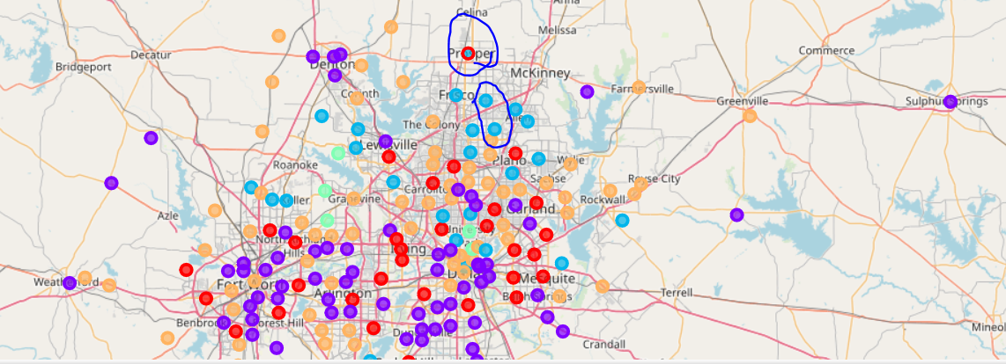
Results
Prosper TX is the clear winner
In the same cluster as the other 2 locations
Has a high kids to school ratio
Close to the other 2 locations

Slide 7
Conclusion
Given proper data set, K means is an effective way to cluster like datasets
In this scenario, the neighborhoods with high income and higher percentage of children under age of 5 were clustered together
Simple math was then used to find the best zip code with least competition

